Slide 1
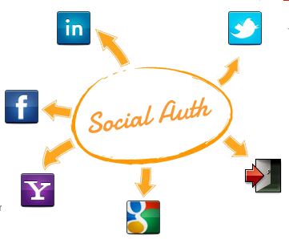
Access Management Essentials Harippriya Sivapatham

Slide 2
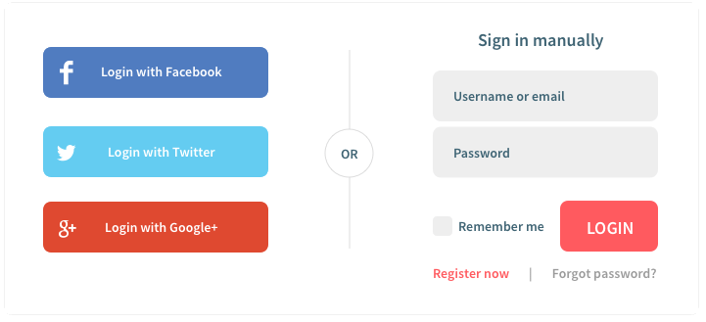
What is Social Auth
Authentication using social identity

Slide 3
Why Use Social Auth
Avoid user maintenance cost but still:
Secure resources
Example: http://forums.novell.com
Personalize content
Simplify User experience while having full access control
Apply policies
Analyze risk and step up

Slide 4
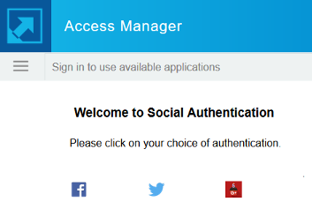

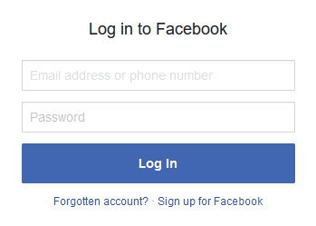
How it Works – Transient Login
1
6
Creates session and Provides access
IDP
OAuth
Client
Social Auth library
3
Redirects
2
User logs
Into Facebook
4
Sends access token
5
Get user profile
OAuth Provider

Slide 5
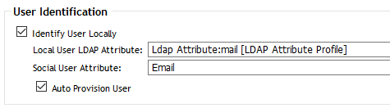
How it Works – User Mapping
5
User profile from provider
Note: User must exist. No auto provision.
Local user found?
No
Prompt User to login to IDP
Save the mapping in LDAP
Yes
Authenticated Experience

Slide 6
Implementation Overview
Open source Social Auth library handles the communication with the social auth providers.
Social auth JSPs handle the redirects of social auth login.

Slide 7
Configuration Steps
Register IDP with Facebook
Login to Facebook and Register as a developer.
Create new App. Note down the App ID and Secret.
Add new Product, choose Facebook login. Enter URLs:
Deauthorize Callback URL:
https://<IDP URL>:<Port Number>/nidp/app
Valid OAuth redirect URIs:
https://<IDP URL>:<Port Number>/nidp/jsp/socialauth_return.jsp
Create an Social auth class, auth method and contract
Login to portal

Slide 8
Demo

